Slide 1
Inversion of a Dirac matrix
By
Lateef Abdul (2037055)
Nitin Sethi (2037064)
Prof Dr. Lukas Varnhorst

Slide 2
Contents:
Introduction
Explanation and procedure
Part 1
Part 2
Part 3
Conclusion

Slide 3
Introduction
The Dirac matrices, named after Paul Dirac, are a set of matrices used in theoretical physics to describe the behavior of fermions. They are used in the formulation of the Dirac equation, which describes the relativistic motion of particles with spin 1/2. There are four matrices, usually denoted as gamma matrices, which satisfy a set of anti-commutation relations and play an important role in the theory of quantum field theory.

Slide 4
Explanation and procedure Part 1
To start we constructed a neighbour table, which just gives a matrix with 4 rows and columns are dependent on the lattice size you take.
The each column of this table would give us the 4 neighbours of that element in the lattice.
Now we wrote a function that calculates the Dv using the above matrix and here, v is a unit vector and D is Dirac matrix.
Each time our function returns a column of the dirac matrix depending on the unit vector used.

Slide 5
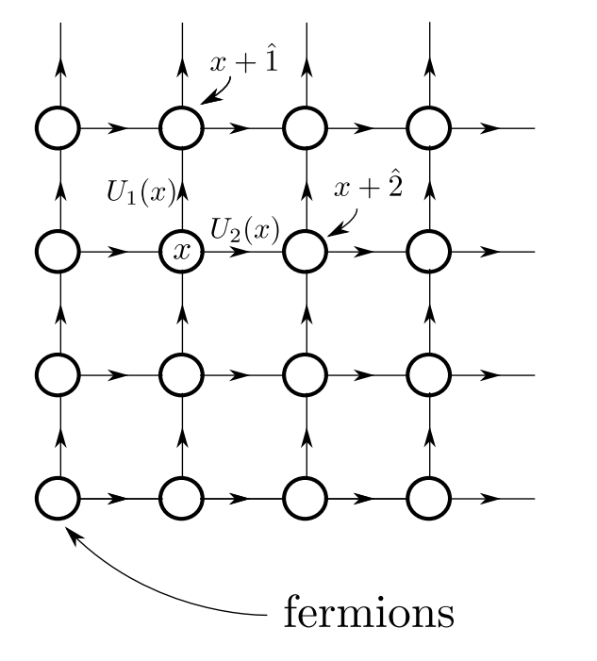
Neighbourhood matrix for 8x8 lattice:

Slide 6
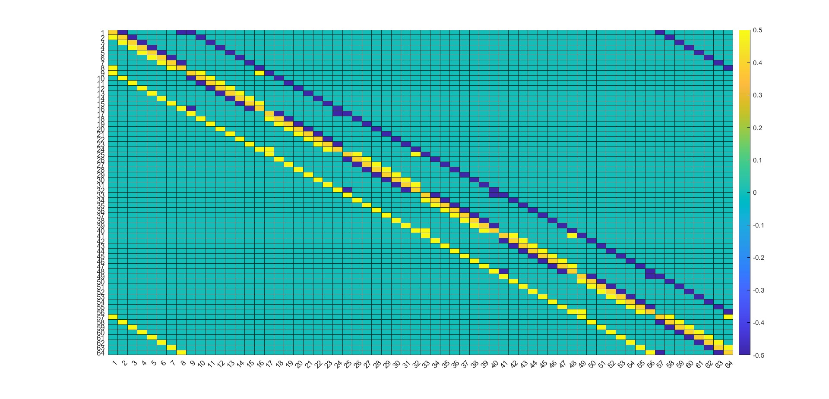
Now we took a 8x8 lattice as mentioned and applied the function we constructed to get all the columns of the Dirac matrix and plotted it in 2d heatmap.

Slide 7
Explanation and procedure Part 2
In this part, the idea is to get the Inverse of Dirac matrix.
For that we can use Conjugate gradient method,
The Conjugate Gradient Method is an iterative optimization algorithm used to solve systems of linear equations, specifically for symmetric positive-definite matrices.
Since our dirac is not completely symmetric and positive definite, here we can use some matrix properties and apply CG algorithm on that as mentioned in the question.
Now we plotted a similar plot as last one for inverse Dirac matrix.

Slide 8
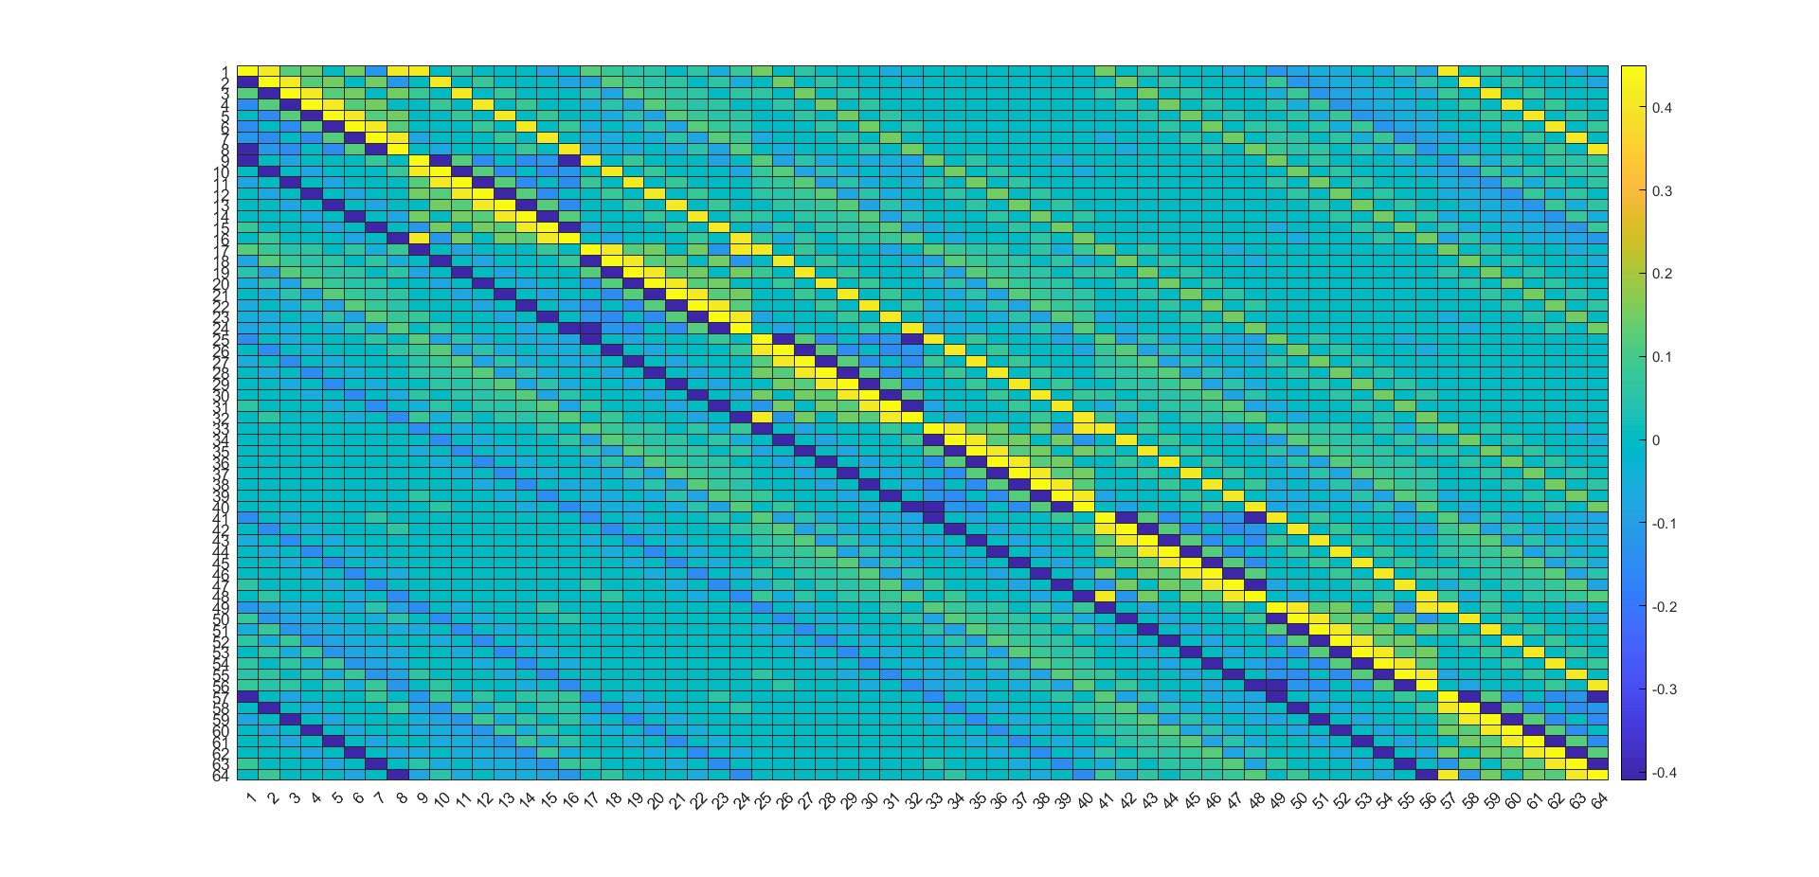

Slide 9
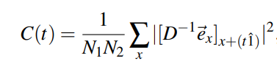
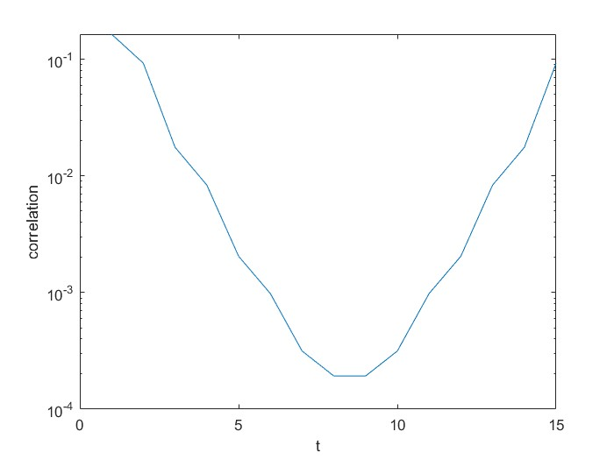
Now we have a correlation function i.e.,
This id the absolute value of the inverse matrix between all points separated by a distance t in 1-direction.

Slide 10
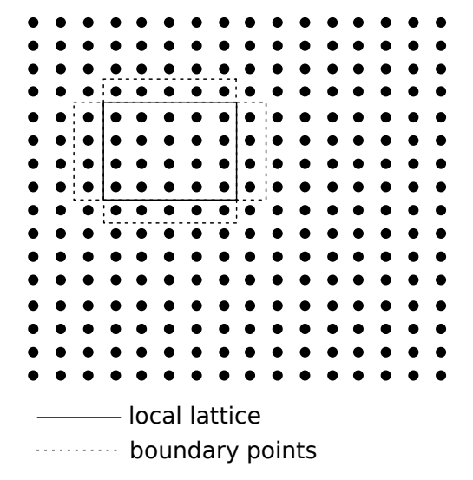
Explanation and procedure Part 3
In this part we parallelize our code using MPI.
For this case we consider all U’s to be 1. And we divide our lattice into sublattices such that each processor will have access to only those sublattices.

Slide 11
Now we make our dirac function into parallel, such that each processor calculates their own sublattice.
For that we communicate the boundaries with adjacent processes.
Now we run the code for different subvolumes and note the time taken for each and plotted it.

Slide 12
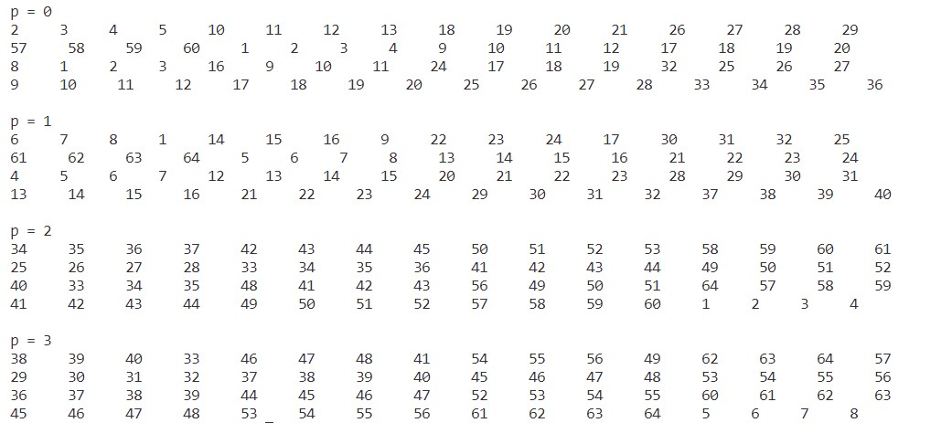
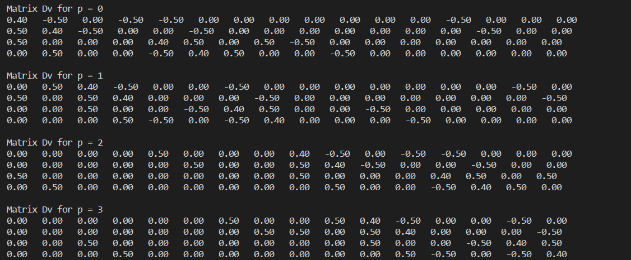
Neighbourhood table for 8x8 lattice using parallelization:
Dirac matrix 4x4 lattice using parallelization:

Slide 13
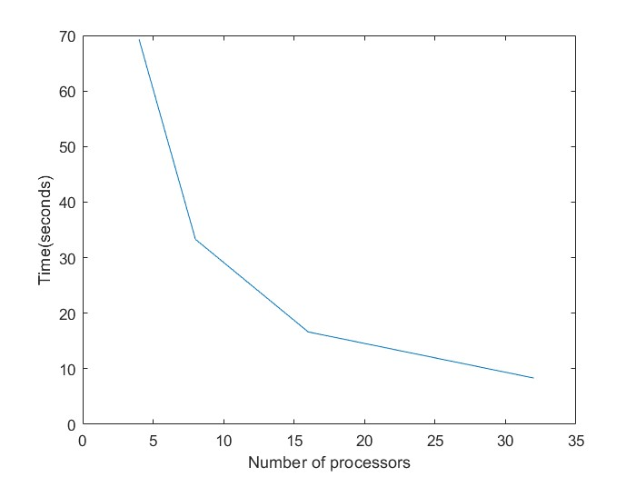

Slide 14
Conclusion
Hence by using the above algorithms and methods, we can calculate and observe a certain matrix which depends on the gauge field and can be inverted and/or applied to any vector.
And also we can observe the positive time scaling as we use parallelization.

